Slide 1
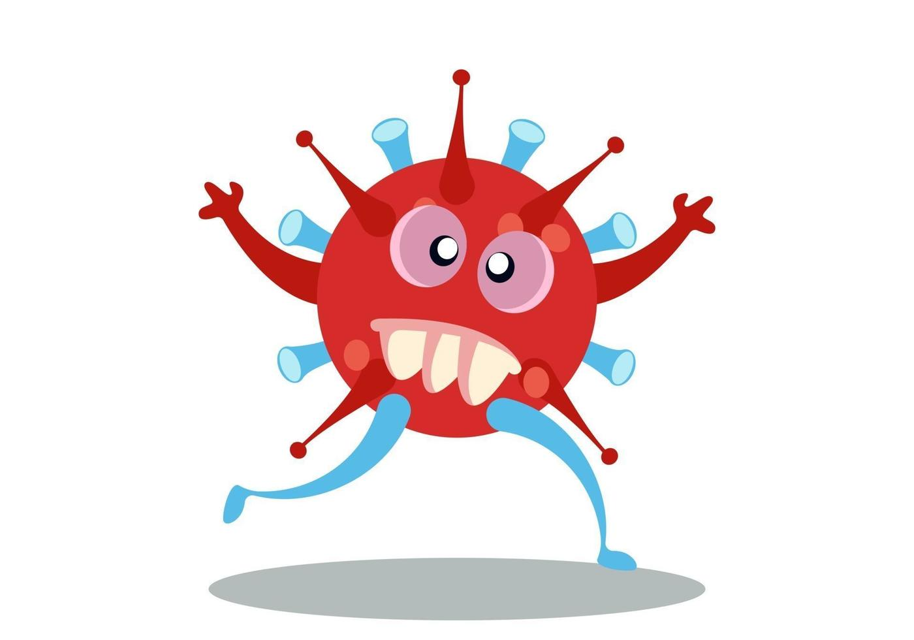
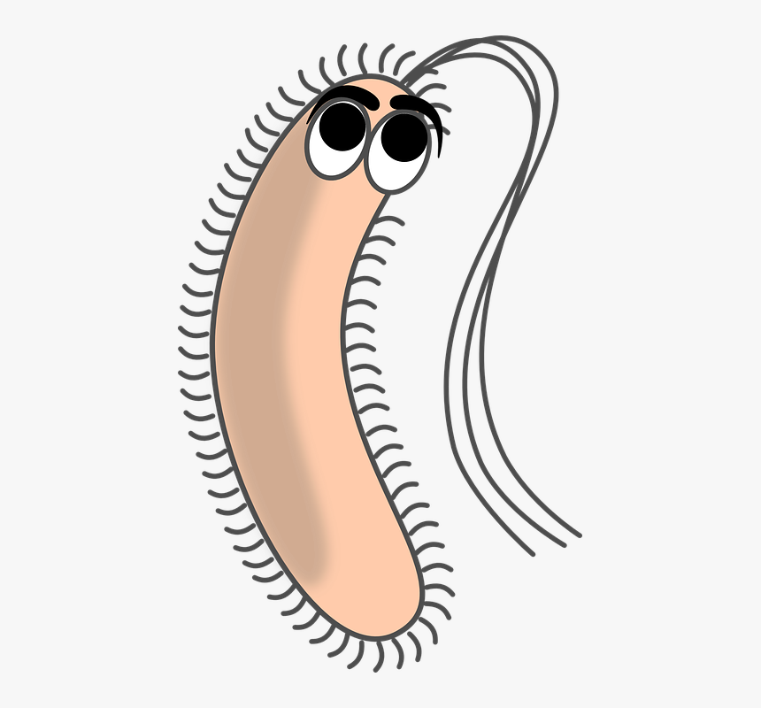
What is a microbe?

Slide 2
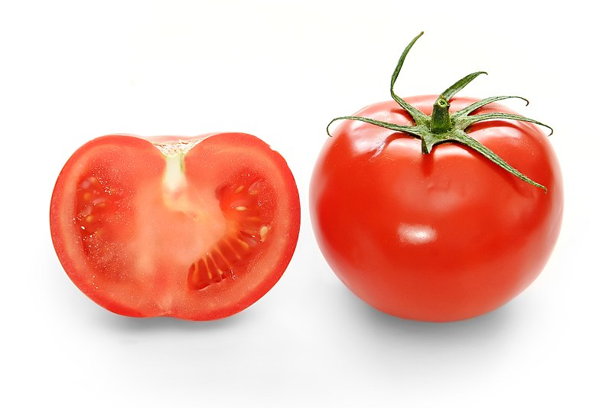
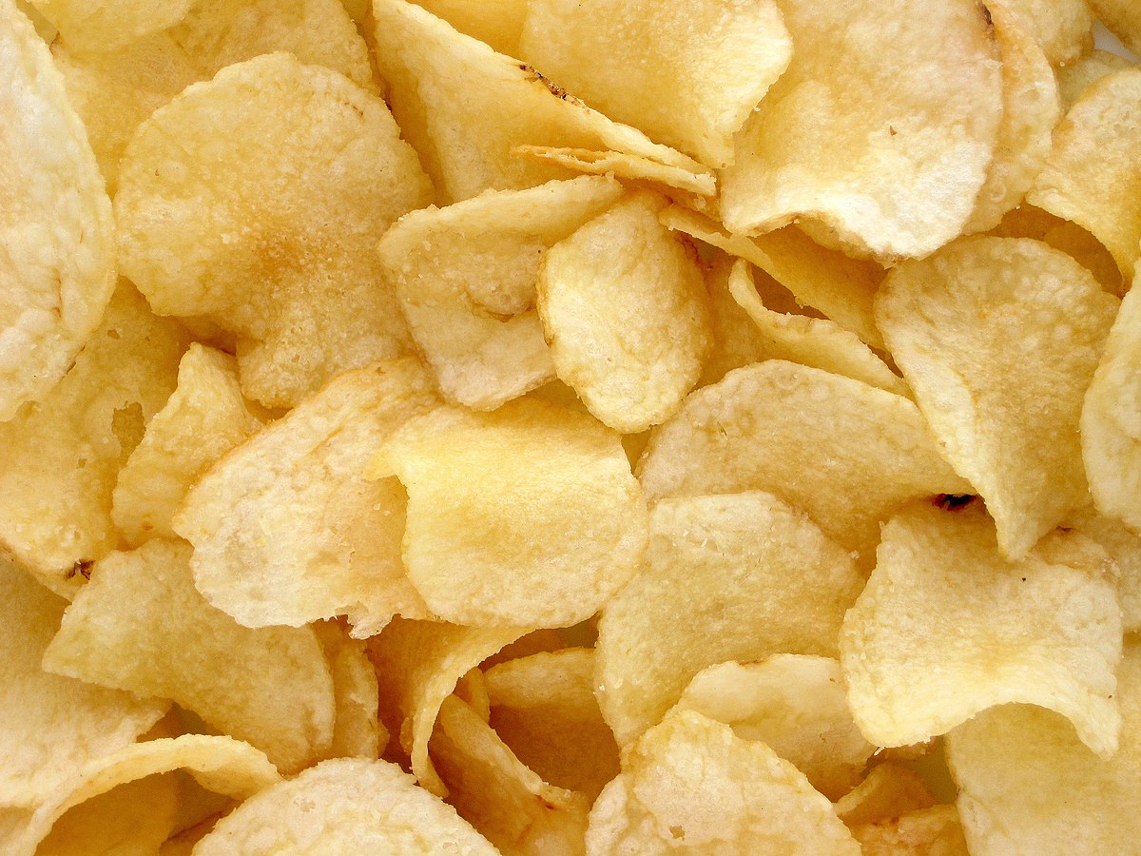
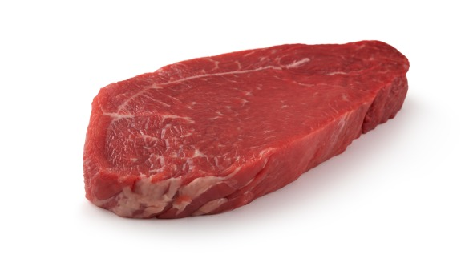
Where do microbes live?
Proper environment: humidity, temperature and gas
Good energy resource: carbon and nitrogen

Slide 3
Exceptions Places You Would Never Expect To Find Bacteria
The cleanest place on earth: Nasa ‘Clean Rooms’
“…In our case, [the spacecraft] is the patient.” technical deputy program manager said.
An entirely new genus of bacteria was discovered in not one, but two NASA clean rooms. Named Tersicoccus phoenicis (“Tersi” is Latin for clean), this bacterium has earned a reputation for outwitting the most intense industrial cleaners and sterilization techniques.

Slide 4
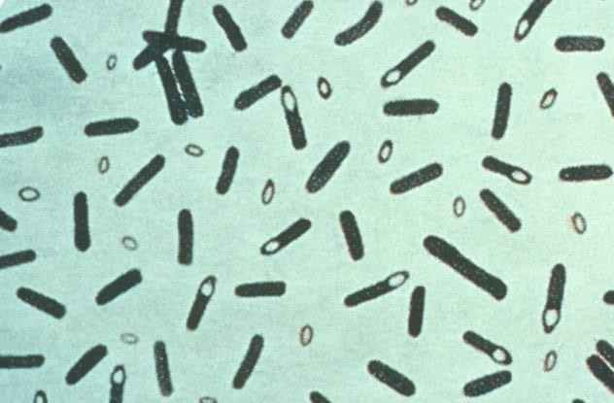
Boiling water
Some bacteria, such as Clostridium botulinum, can survive in boiling water.
Clostridium botulinum, which is responsible for botulism (a serious paralytic condition caused by a nerve toxin that can enter the body either through food intake or an open wound), prefers environments with relatively little oxygen, which is why it can grow and live in the most unnerving places, such as in your camp kettle or along the inside of a sealed can.
it is best to use bleach, sodium hydroxide, and extreme temperatures (around 120 degrees Celsius) when trying to eradicate this pesky beast.

Slide 5
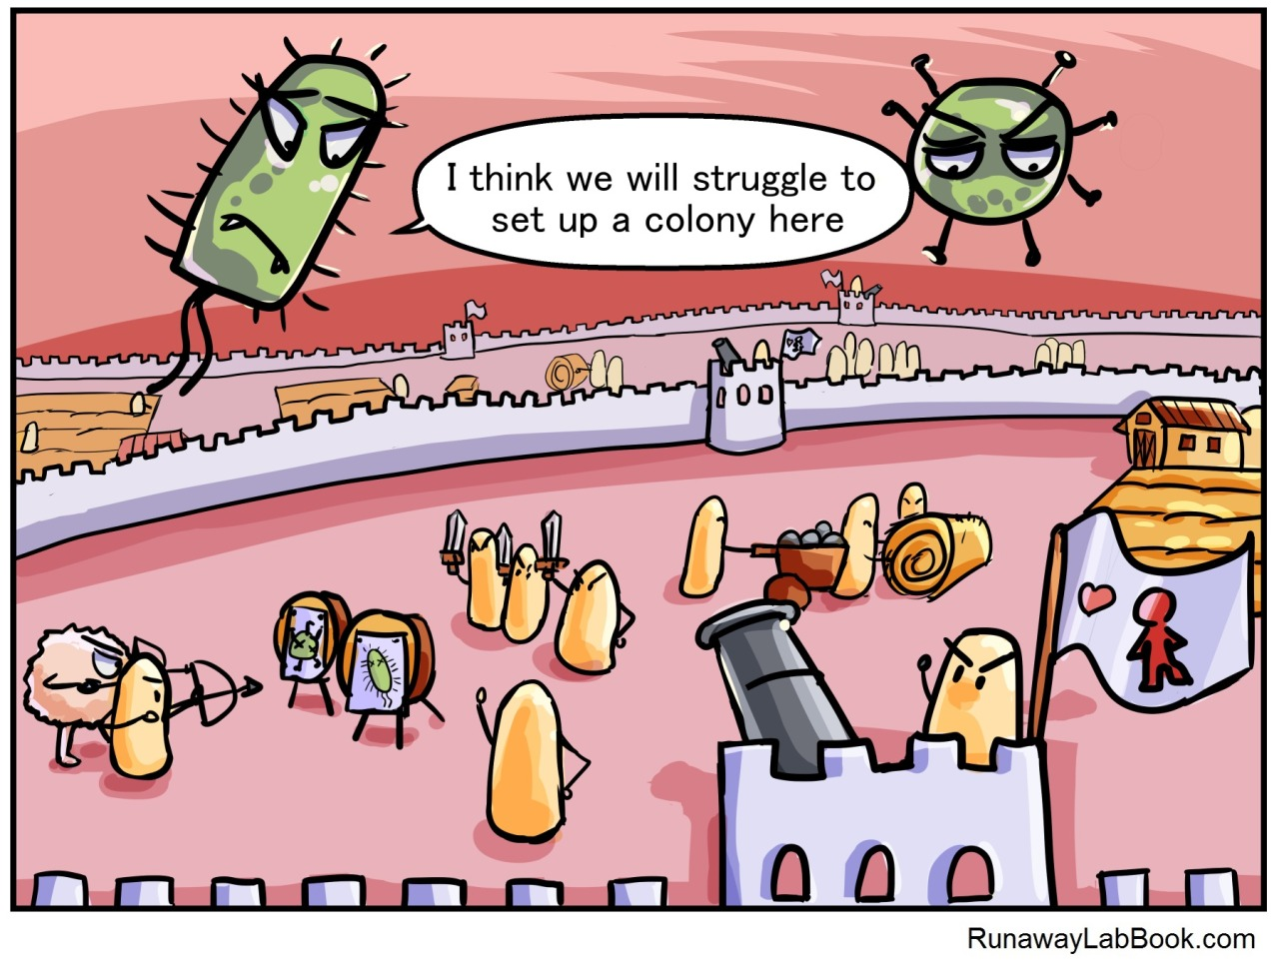
What’s up with your gut microbiome?

Slide 6
Questions:
Did the video change your definition of what a microbe is?
Are all microbes harmful or bad?
How can some microbes benefit us?

Slide 7
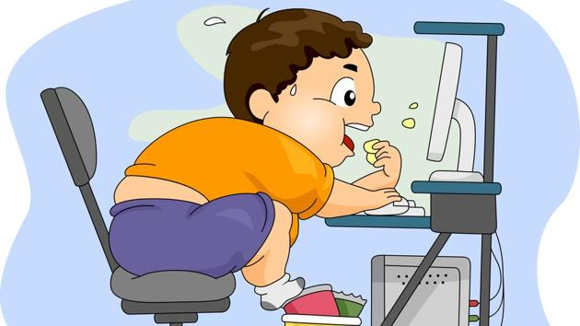
An example of the consequence when the homeostasis in the gut is disturbed?

Slide 8
Crosstalk between the gut microbiota and circadian rhythms in the regulation of metabolism
Gut microbiota also shows circadian rhythms in abundance
Germ-free mice have distinct circadian rhythms
Germ-free mice are leaner
Obese people have different gut microbiota
Fecal transplantation transfers the obesity phenotype
Shiftwork
Jetlag
Mouse models
Intestinal epithelial cells

Slide 9
Fun Experiments
Germ-Glow
Observing your microbiota

